Slide 1
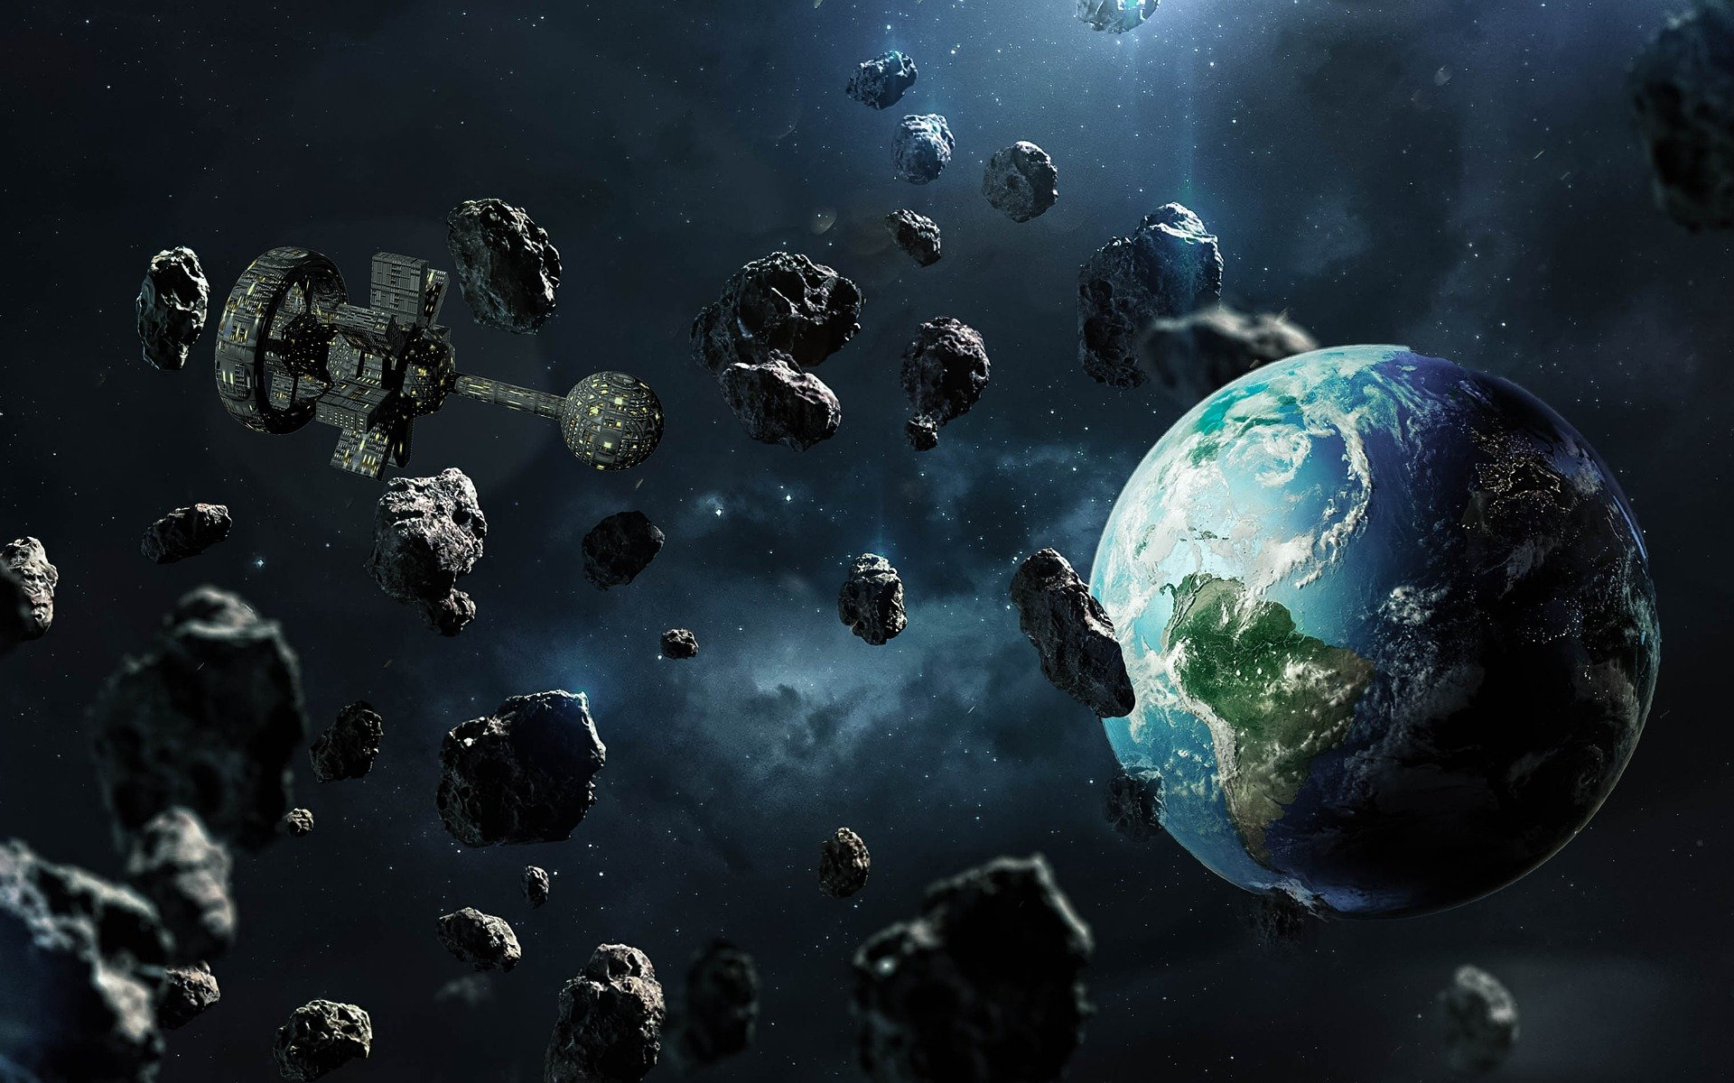
Asteroid´s orbit classification (Near Earth Asteroids)
Yuliya Goncharuk

Slide 2
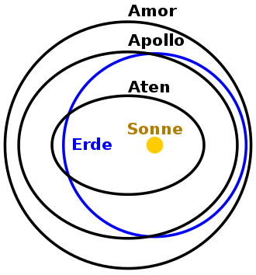
Near Earth Asteroids
The term "asteroid" refers to the minor planets of the inner Solar System. Asteroids are vary greatly in size, from almost 1000 km for the largest down to rocks just 1 meter across. Larger asteroids are often called planetoids.
Near-Earth asteroids are asteroids that have orbits that pass close to that of Earth. If the object is larger than 140 meters across, it is considered a potentially hazardous object (PHO).
AMO="Amor", APO="Apollo", ATE="Aten", or IEO="Interior Earth Object". A trailing "*" indicates the object-- is also a potentially hazardous asteroid.
(AU)-- astronomical unit (or AU) is a unit of length, roughly the distance from Earth to the Sun and equal to about 150 million kilometres

Slide 3
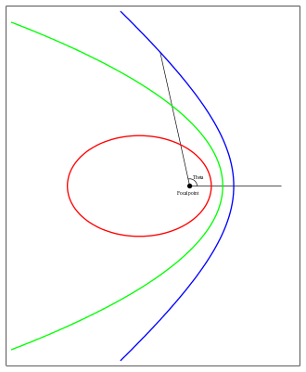
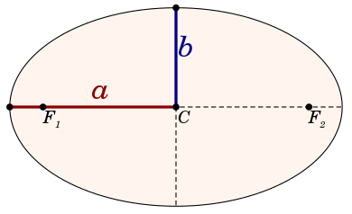
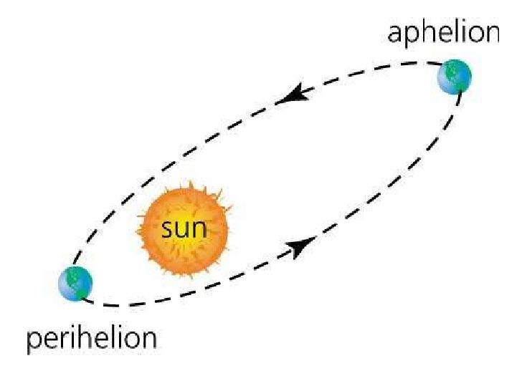
Orbital classification
Asteroids are commonly categorized according to two criteria: the characteristics of their orbits, and features of their reflectance spectrum.
Near-Earth asteroids are divided into groups based on their semi-major axis (a), perihelion distance (q), and aphelion distance (Q):[
The semi-major (a) and semi-minor axis
(b) of an ellipse
the orbital eccentricity is a dimensionless parameter that determines the amount by which its orbit around another body deviates from a perfect circle

Slide 4
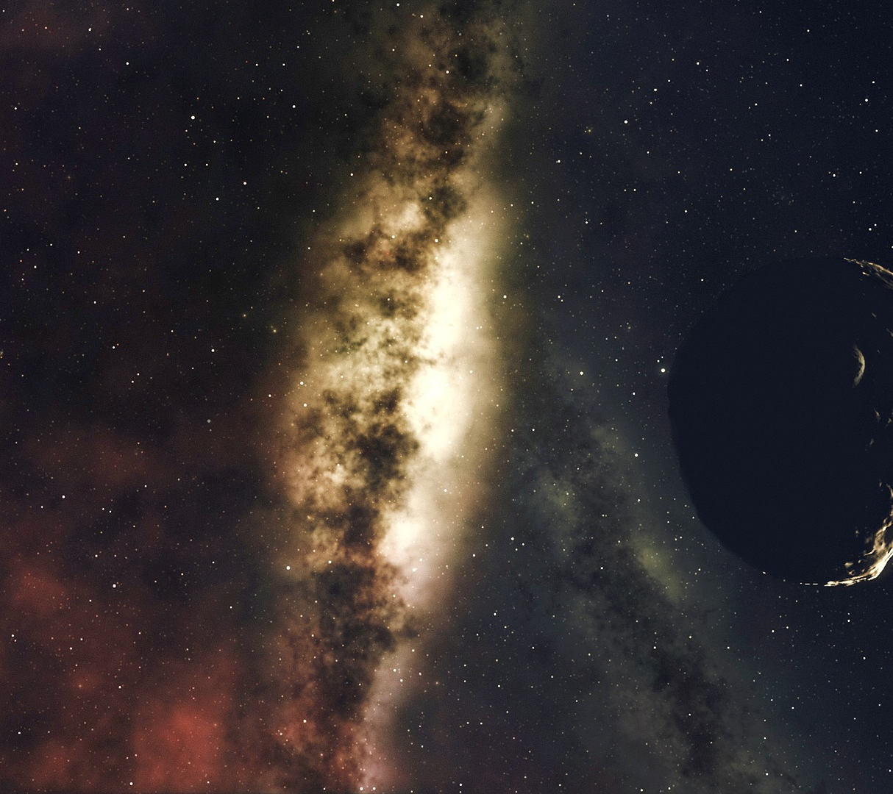
Dates:
a (AU) -- Semi-major axis of the orbit in AU e -- Eccentricity of the orbit i (deg) -- Inclination of the orbit with respect to the ecliptic plane and the equinox of J2000 (J2000-Ecliptic) in degrees w (deg) -- Argument of perihelion (J2000-Ecliptic) in degrees Node (deg) -- Longitude of the ascending node (J2000-Ecliptic) in degrees M (deg) -- Mean anomaly at epoch in degrees q (AU) -- Perihelion distance of the orbit in AU Q (AU) -- Aphelion distance of the orbit in AU P (yr) -- Orbital period in Julian years H (mag) -- Absolute V-magnitude MOID (AU) -- Minimum orbit intersection distance (the minimum distance between the osculating orbits of the NEO and the Earth class -- Object classification:
Data: https://www.kaggle.com/brsdincer/orbitclassification

Slide 5
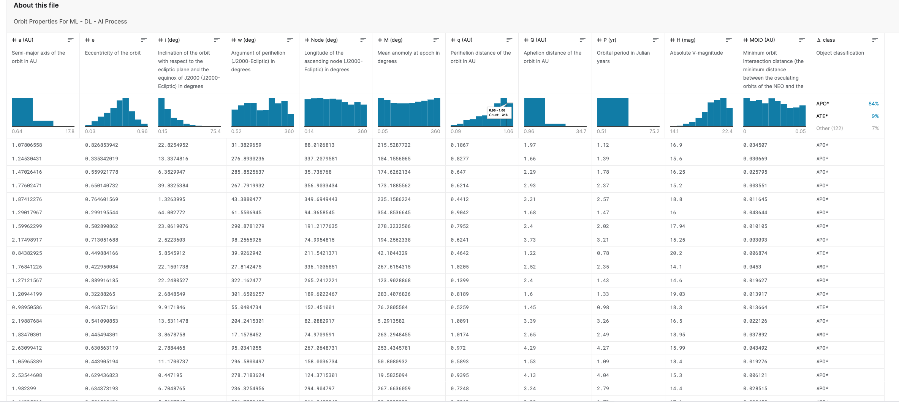
Dataset

Slide 6
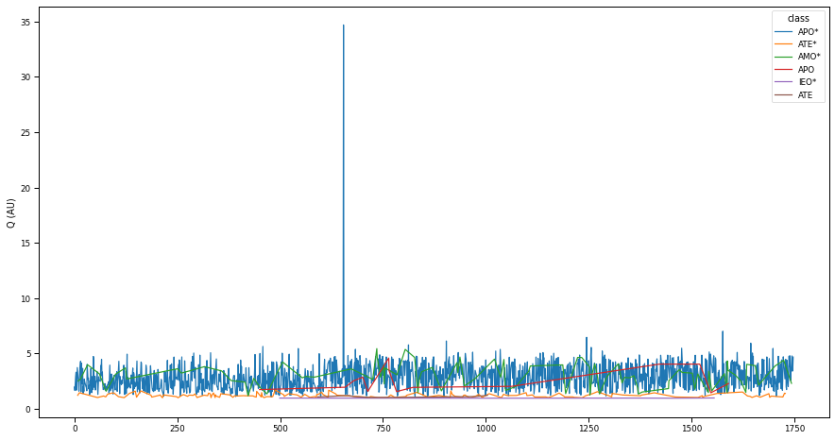
Data preparation
-loading the dates and looking of the first few rows
-looking of the type of the dataset. We can see, that all our dates are numeric
We can see, that we don´t have any missing dates or any duplicates
When we make the value counts of our class classification, we can see, that we have imbalanced dates.
We found only one outlier that we removed.

Slide 7
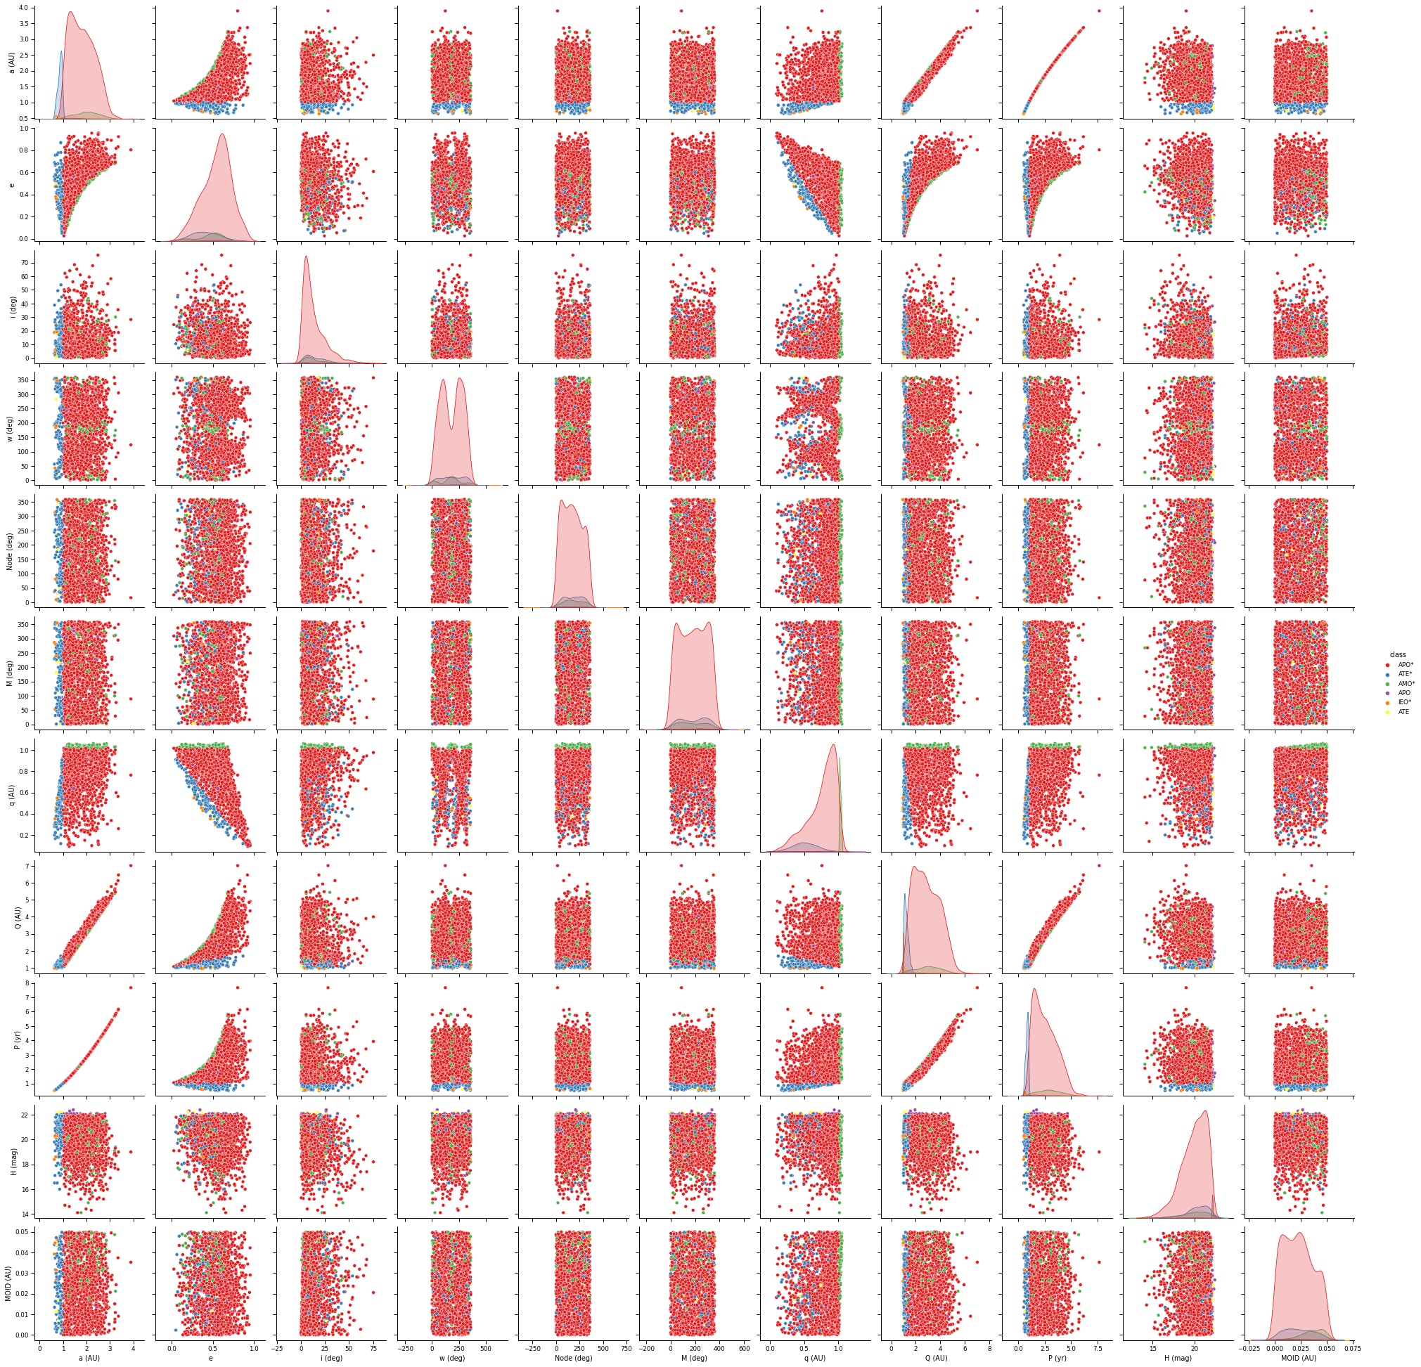
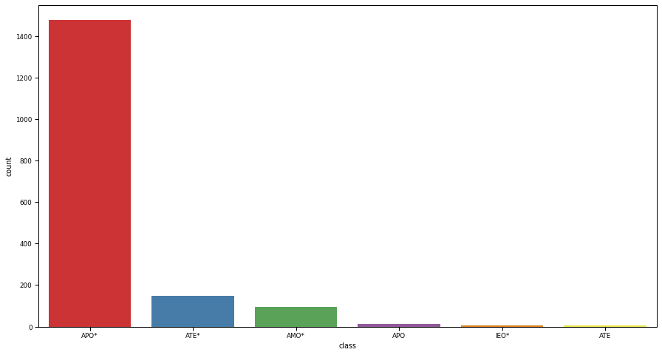
Data Visualization
The visualization of our classes with the help of countplot proved that we have imbalanced dates.
For the better understanding of dependency between our variable we make the visualization with help of pairplot.

Slide 8
Machine Learning Model
After investigation to deal with imbalanced dataset we decided to manually reduce the biggest class to a size nearly to the second biggest class.
Trying to make undersampling. It didn´t work, because after undersampling we have few dates. It is not enough.
trying to use a different method for the oversampling ( SMOTE, BorderlineSMOTE, ADASYN, SMOTEENN, RandomOverSampler)
But all this methods did not improve the accuracy therefore we decided to only work with the reduced dataset.

Slide 9
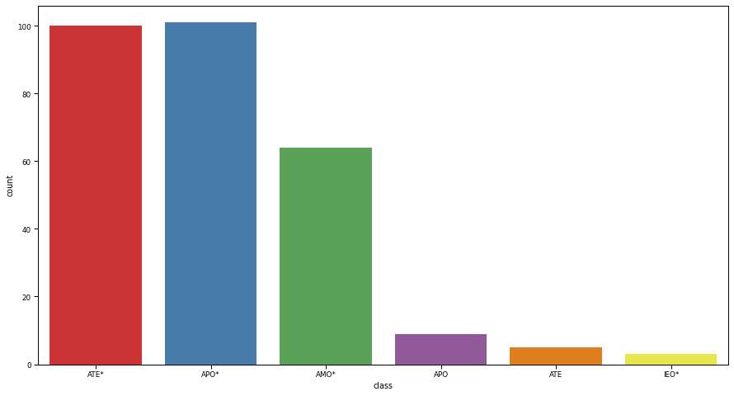
Machine Learning Model Part2
Here is a countplot of the training dataset. Here we can see that it is still imbalanced but not so much as with the original dataset.

Slide 10
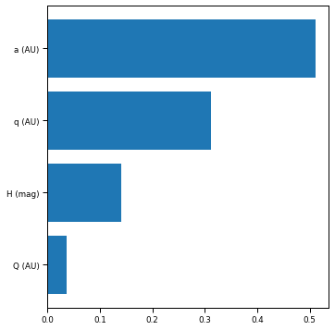
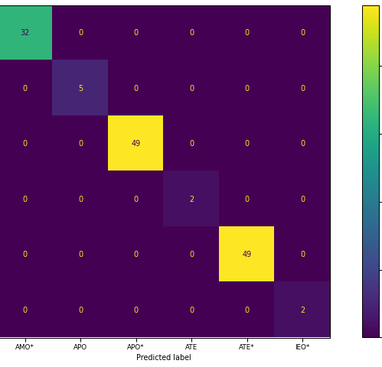
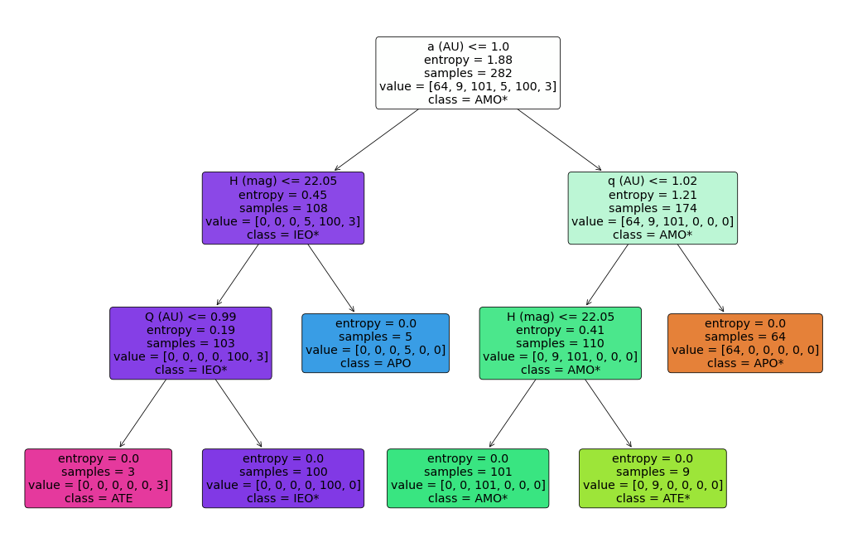
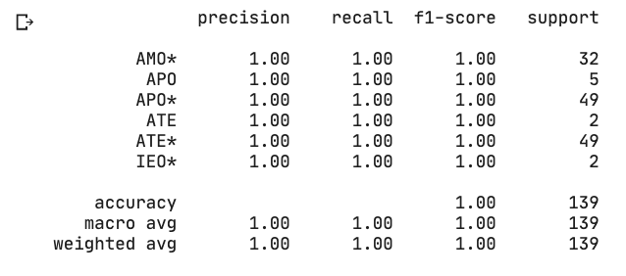
Machine Learning Model Part3
The confusion matrix (top right) shows a too good match with the training set.
The same is with the classification report on the lower right.
The fitted decision tree (bottom left) shows that in most cases only 3 decisions are needed to classify the asteroids.
The features importance graph(top left) shows the importance of the parameters they are a (AU), q (AU), H(mag), Q(AU)

Slide 11

Conclusion
Despite of the fact that we have this high accuracy in the model building we think that this classifier works well.
The features like a (AU), q (AU), Q(AU) and H(mag), are all distances and therefor have a direct dependency to the classification.
When looking at the decision tree we can easily understand which distance is used to classify the asteroids.

Slide 12

.

